Slide 1



Customer Churn in Telecom Subscription-based Businesses
Group 7: Hong Khanh Che, Ankit Malhotra, David Bezhanyan, Zih Yu Chen

Slide 2
TABLE OF CONTENTS
1
2
Research Objectives
Motivation
3
Exploratory Data Analysis
4
Data Modeling
5
Conclusions and Recommendations

Slide 3
1
MOTIVATION

Slide 4



Project Focus: Analyze customer churn rates and CLTV to improve management of subscription-based businesses.
Goal of Churn Prediction: Identify at-risk clients and develop targeted retention strategies.
Integration of CLTV Analysis:
Enhance profitability through strategic business decisions.
Gain deeper insights into customer behaviors.
Product and Service Refinement: Emphasize the refinement of offerings to reduce churn rates.

Slide 5
2
RESEARCH OBJECTIVES

Slide 6

TWO OBJECTIVES
Churn Reduction and Retention Strategy Development
Enhancing Customer Acquisition and Retention through Behavioral Insights
Identify the main reasons for customer churn and reduce churn by identifying potential switchers. The churn rate directly impacts revenue and profits. Understanding the factors influencing it will help develop strategies to reduce customer churn and retain valuable customers.
Develop new products and efficient marketing campaigns by understanding customer behavior trends. This understanding will not only improve the experience of existing customers but also attract potential customers, thereby benefiting telecom subscription-based businesses.

Slide 7
3
EXPLORATORY DATA

Slide 8

7043
33
Multiple data types
observations
variables
Categorical, Numerical, Geographic, Identifier, Metric

Slide 9
DATA GAPS
Geographical limitations
Incompleteness in Analysis
Limited Scope of Variables
This dataset doesn't include enough potential variables, such as promotions, employment status, income level, and service modification, as expected. These indicators relevant to the study can limit the depth of analysis and be an obstacle to evaluating how building a promotional strategy affects customer retention or switching.
Limited data on locations, specifically solely in California, USA, might skew understanding of infrastructure challenges or successes in different terrains or urbanization levels because the state's geography varied from coastal areas to mountainous regions.
The absence of a CLTV calculation method can hinder deep analytical insights that are crucial for strategic decision-making. CLTV helps us understand customer profitability, guide marketing spending, and optimize customer relationship management strategies.

Slide 10
Churn Value-Target
non-churning customers
churning customers
73.5%
26.5%

Slide 11
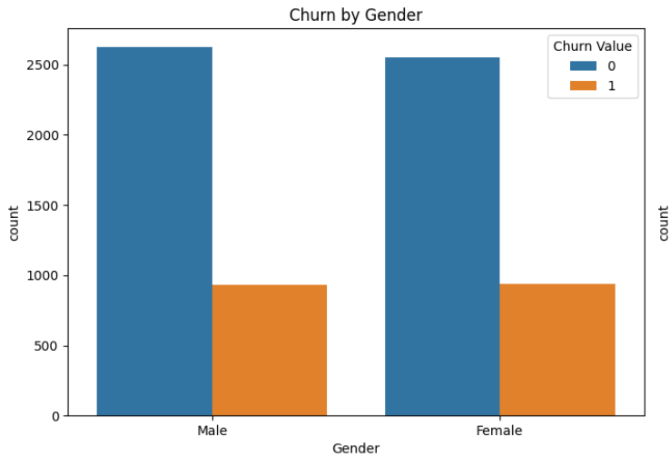
Gender
Male 50.5%
Female 49.5%

Slide 12
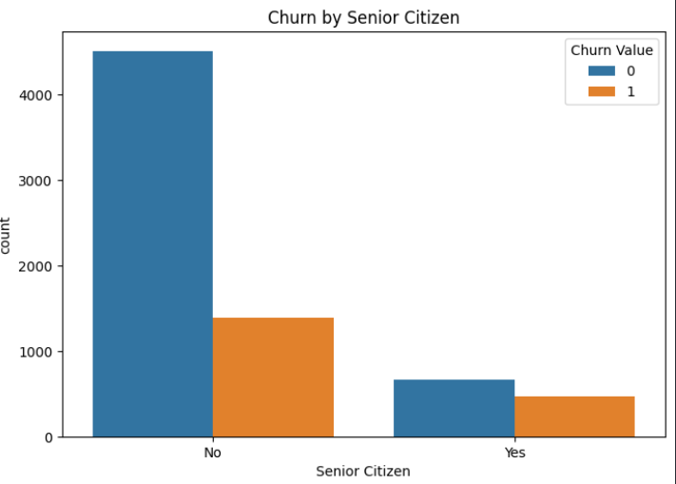
Senior Citizen
No 83.8%
Yes 16.2%

Slide 13
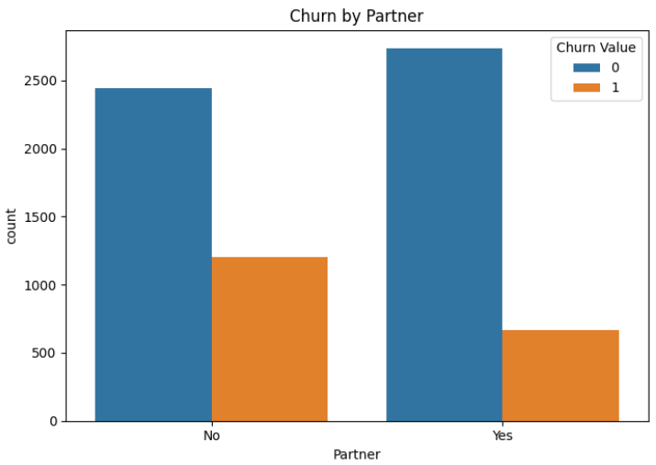
Partner
No 51.7%
Yes 48.3%

Slide 14
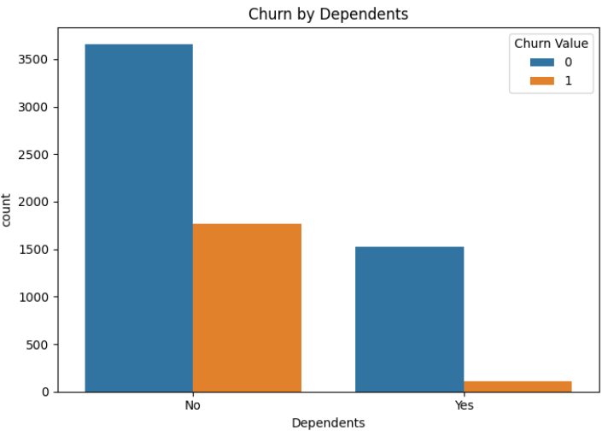
Dependents
No 76.9%
Yes 23.1%

Slide 15
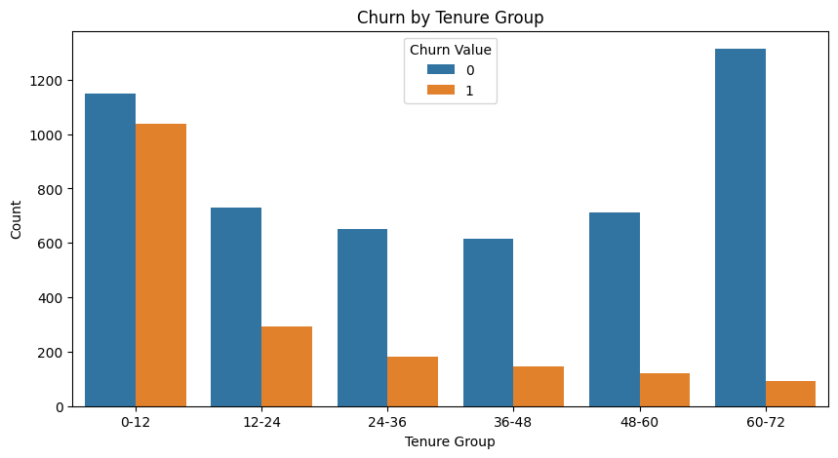
Tenure Group
0-12 30.9%
12-24 14.6%
24-48 22.7%
48-60 11.8%
60-72 20.0%

Slide 16
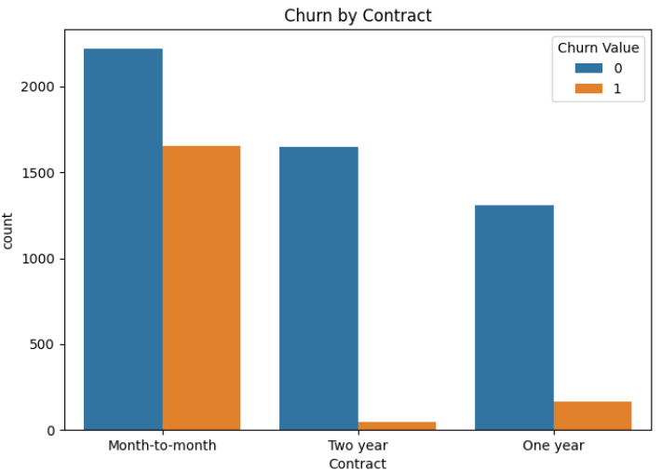
Contract
Month-to-month 55.0%
Two year 24.1%
One year 20.9%

Slide 17
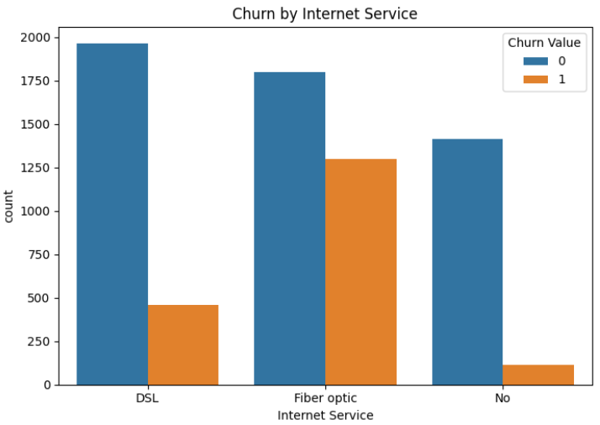
Internet service
Fiber optic 44.0%
DSL 34.4%
No 21.7%

Slide 18
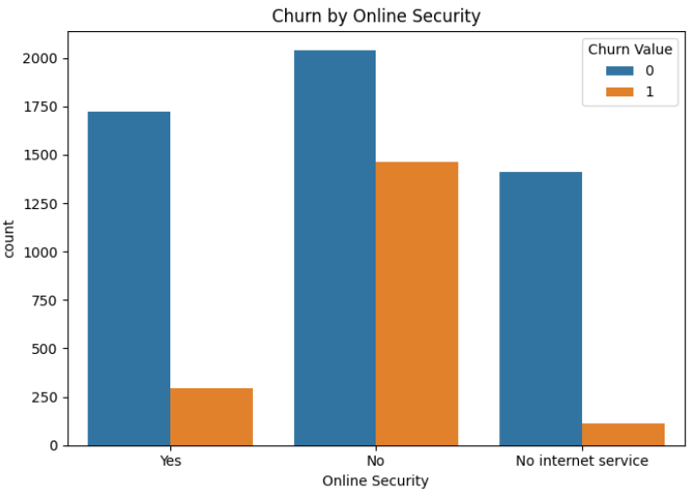
Online security
No 49.7%
Yes 28.7%
No internet service 21.7%

Slide 19
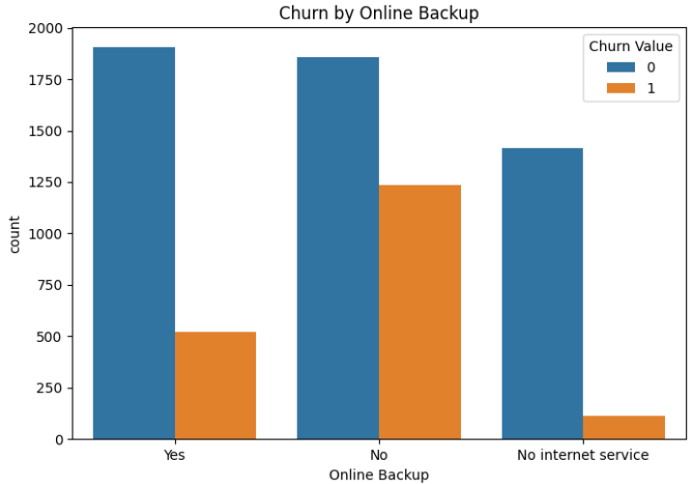
Online Backup
No 43.8%
Yes 34.5%
No internet service 21.7%

Slide 20
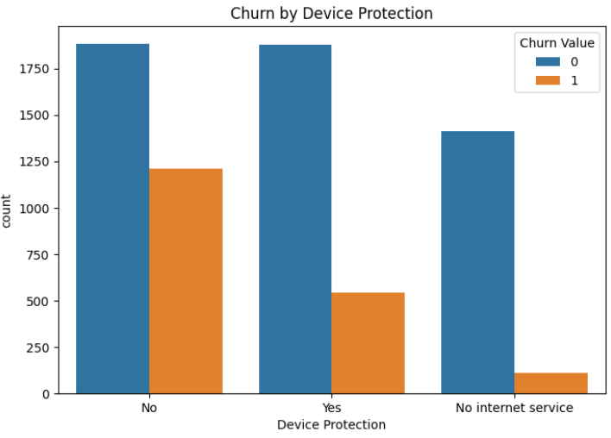
Device Protection
No 43.9%
Yes 34.4%
No internet service 21.7%

Slide 21
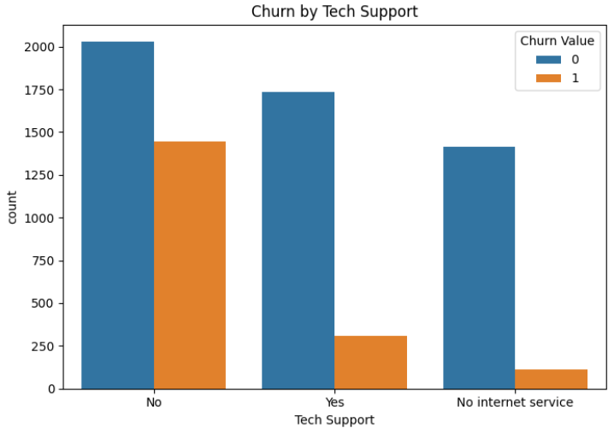
Tech Support
No 49.3%
Yes 29.0%
No internet service 21.7%

Slide 22
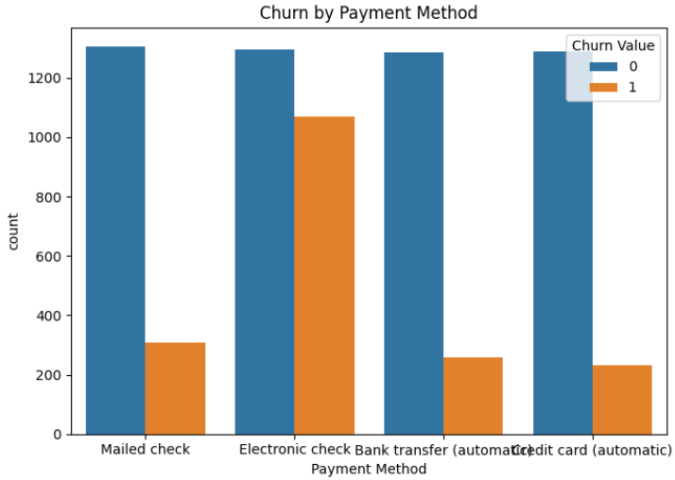
Payment Method
Electronic check 33.6%
Mailed check 22.9%
Bank transfer (automatic) 21.9%
Credit card (automatic) 21.6%

Slide 23
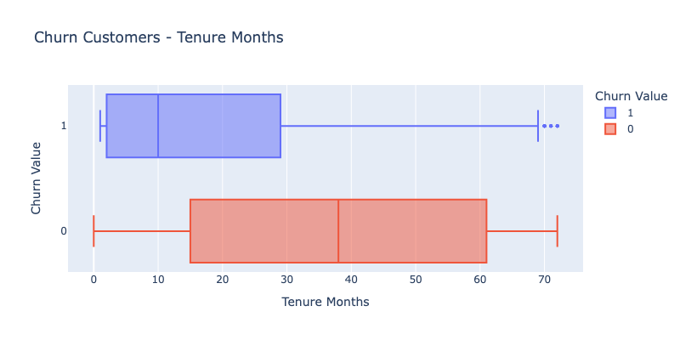
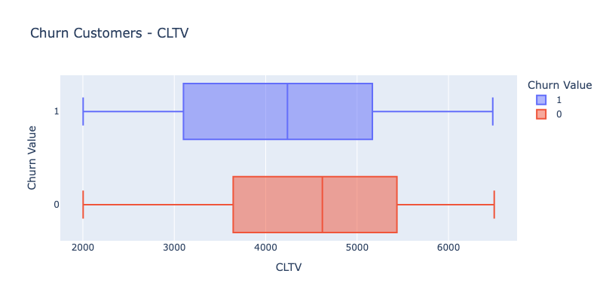
Churn Value - CLTV and Tenure Months

Slide 24
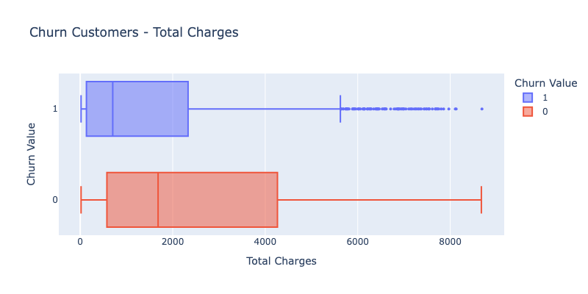
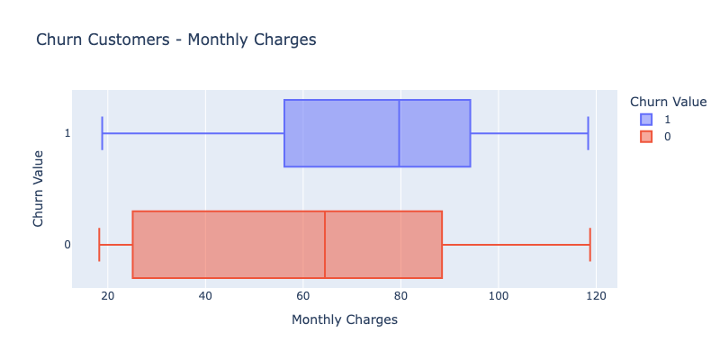
Churn Value - Total Charges and Monthly Charges

Slide 25
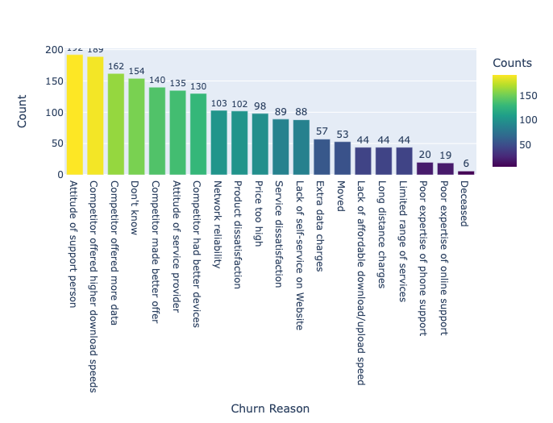
Churn Reason

Slide 26
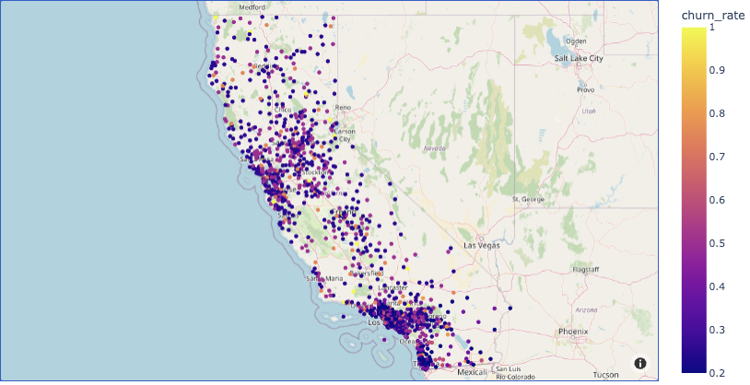
Location

Slide 27
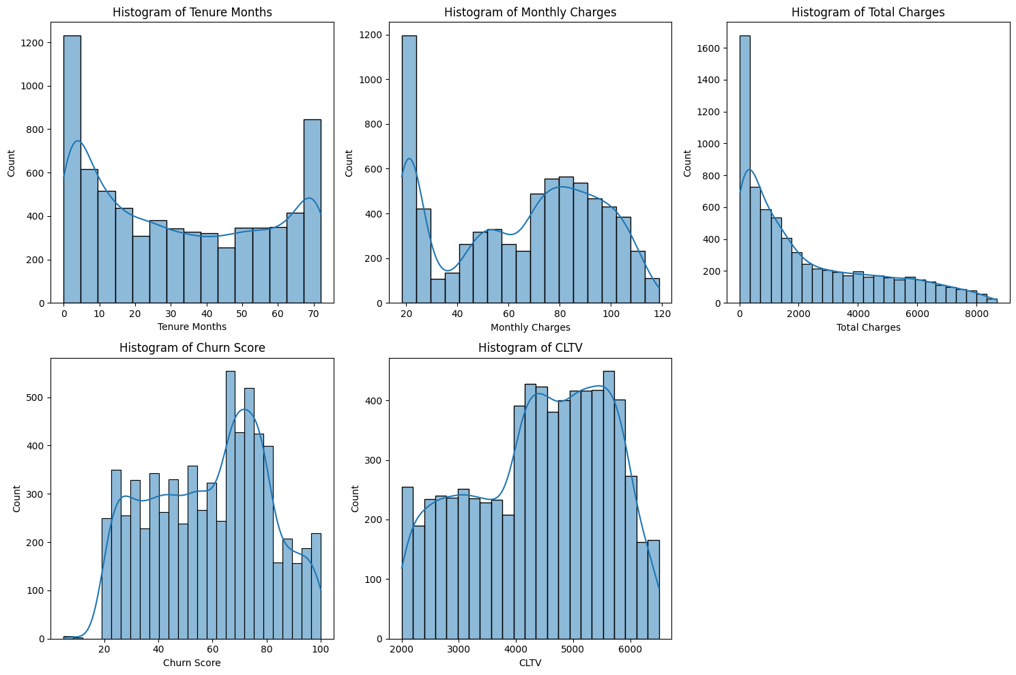
Data Visualization (cont.)

Slide 28
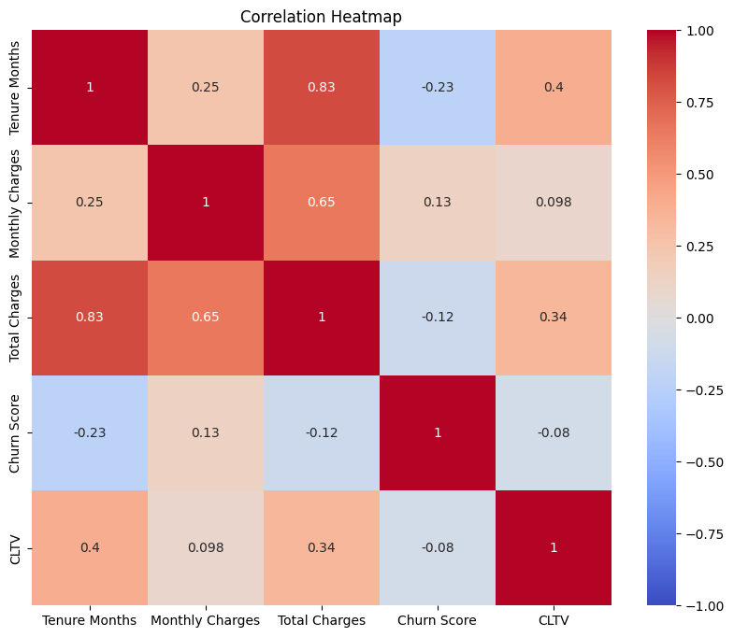
Heatmap

Slide 29
4
DATA MODELING

Slide 30
MODELS
SVM
Logistic Regression
Random Forest
K-means
Linear Kernel
Polynomial Kernel
RBF Kernel
After SMOTE
After SMOTE

Slide 31
Model | Accuracy | Precision | Recall | F1 Score
Logistic Regression (After SMOTE) | 0.78 | 0.59 | 0.76 | 0.66
Random Forest (After SMOTE) | 0.78 | 0.59 | 0.66 | 0.62
SVM with Linear Kernel | 0.81 | 0.69 | 0.57 | 0.62
SVM with Polynomial Kernel | 0.8 | 0.72 | 0.48 | 0.57
SVM with RBF Kernel | 0.81 | 0.71 | 0.51 | 0.59
SVM with RBF Kernel (After Hyperparameter Tuning) | 0.81 | 0.71 | 0.56 | 0.63
SVM with RBF Kernel (After Feature Engineering) | 0.79 | 0.65 | 0.52 | 0.58
Neural Network | 0.78 | 0.61 | 0.62 | 0.61

Slide 32
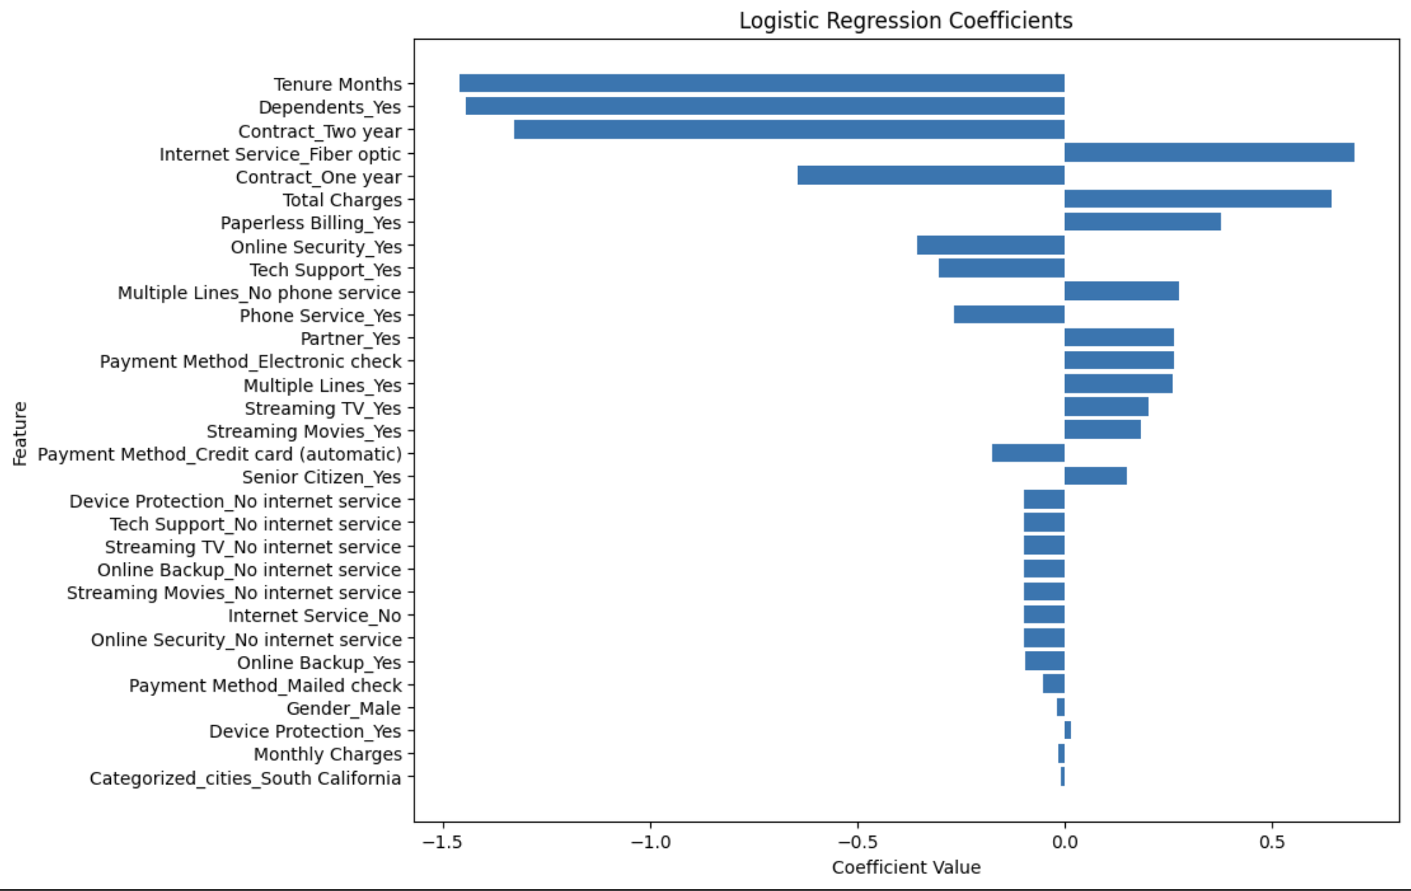
Logistic Regression before SMOTE

Slide 33
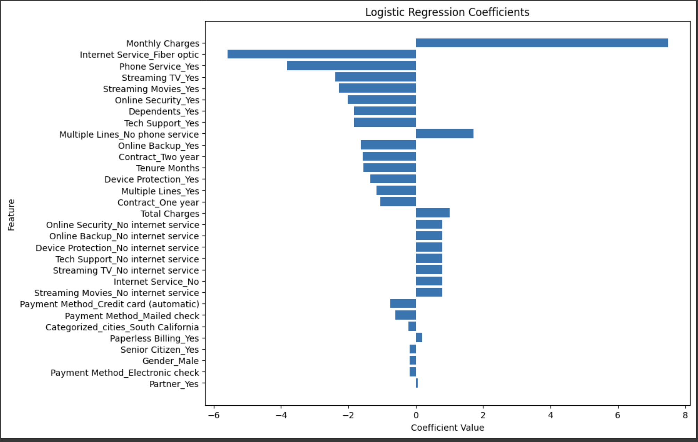
Logistic Regression after SMOTE

Slide 34
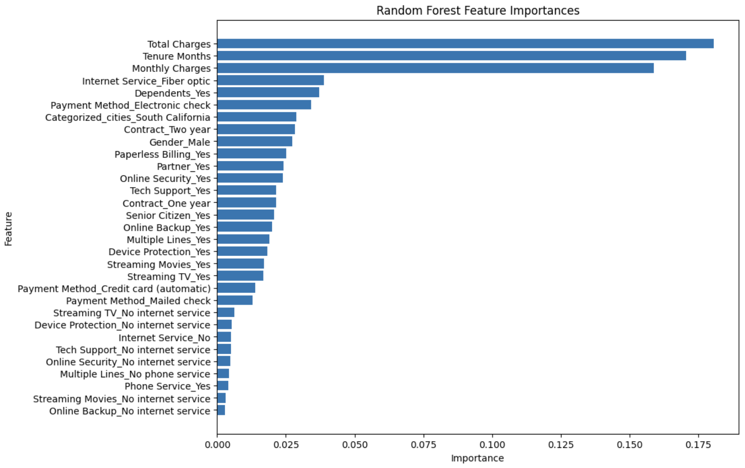
Random Forest Feature Importances

Slide 35
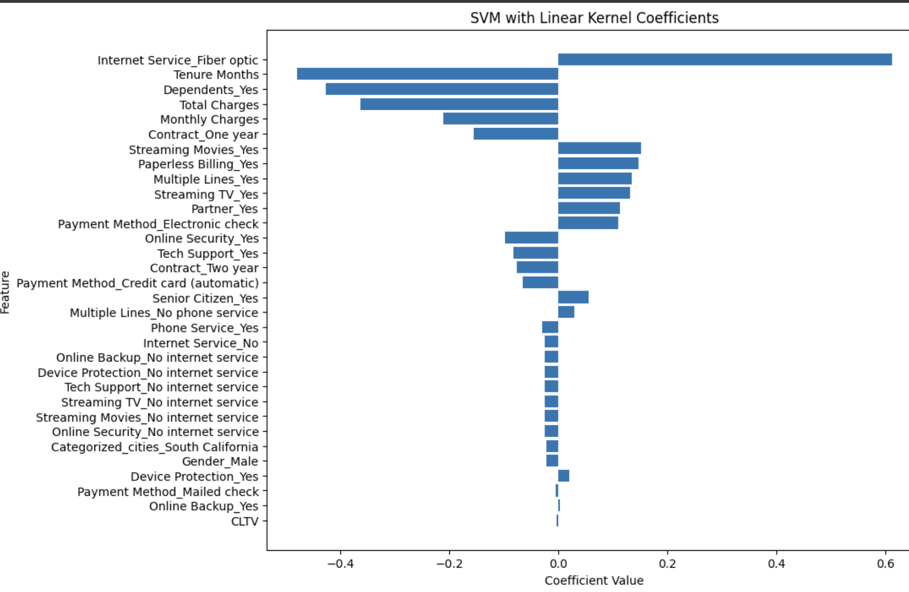
SVM Feature Importances

Slide 36
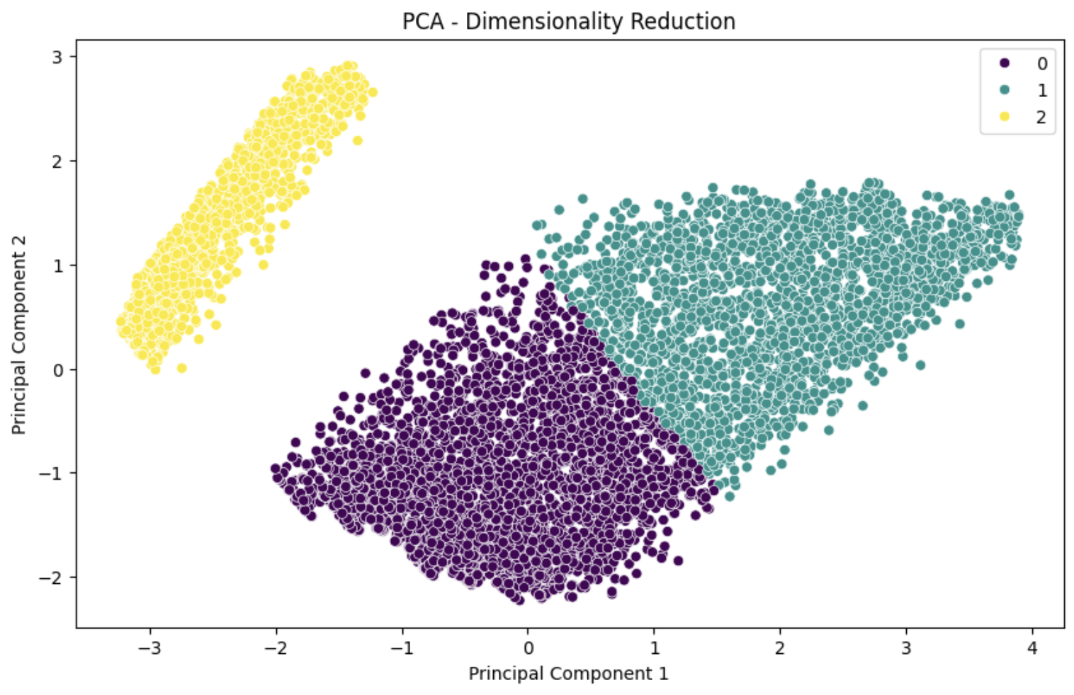
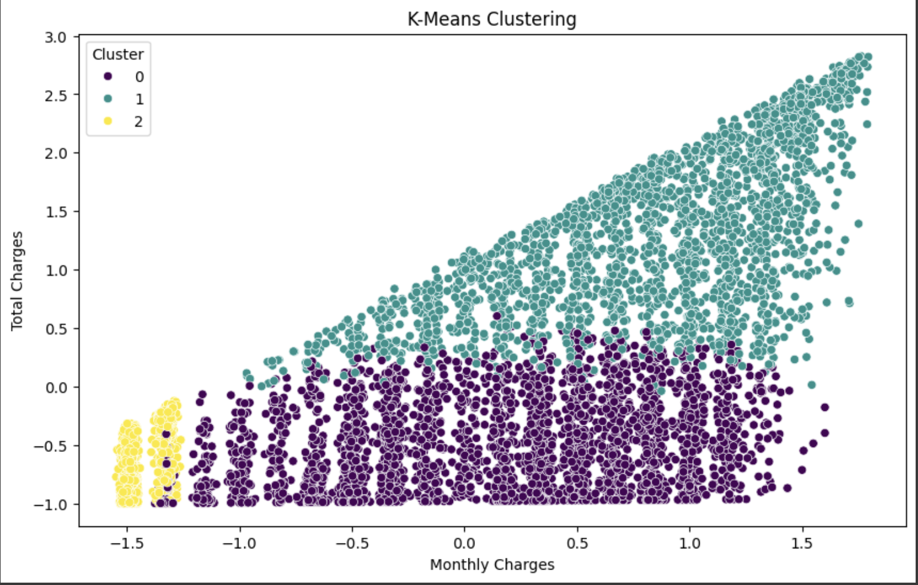
K-Means

Slide 37
5
CONCLUSION AND RECOMMENDATION

Slide 38
CONCLUSION
Best Model: SVM with RBF kernel (Hyperparameter Tuning)
Accuracy: 0.81
F1 Score: 0.63
Alternative Option: Logistic Regression (After SMOTE)
Accuracy: 0.78
F1 Score: 0.66
Reasons for Customer Churn:
Higher cost of fiber services
Unmet high expectations for service quality
Intense competition
Demographic profile
Important Variables:
Total and Monthly Charges
Internet Service (Fiber Optic)
Tenure Months
Dependents

Slide 39
Recommendations
Total and Monthly Charges:
Tiered pricing plans for flexibility and value
Loyalty discounts and bundled services for cost savings
Regular billing review and adjustment for fairness and transparency
Referral programs to reward customers for bringing in new subscribers

Slide 40
Recommendations
Internet Service (Fiber Optic):
Enhanced customer support for fiber optic users
Satisfaction guarantees and trial periods for new customers
Regular feedback collection to improve service quality
Fiber optic-specific strategies like detailed speed and reliability information, flexible data plans, and regular network upgrades

Slide 41
Recommendations
Tenure Months:
Loyalty programs with rewards like discounts, exclusive offers, and early access to new features
Recognition and celebration of customer milestones (e.g., anniversaries)
Personalized support and account management for long-tenure customers

Slide 42
Recommendations
Dependents:
Family-friendly plans with generous data allowances, speeds, and family-oriented content and features
Flexible plans that adapt to changing family needs
Enhanced customer support with trained staff and dedicated support channels for families

Slide 43
THANKS!

